Slide 1

Basic Human Movement Detection using Python3
Department Of Computer Engineering
Domain Name
DIGITAL IMAGE PROCESSING
Member Names:
Pradipt Kalamkar

Slide 2


Problem Statement/ Topic Description
In today’s modern world of CCTVs and surveillance many systems are being developed to track human motion in order to keep an eye on any suspicious person or his activity.
For this our first step will be to detect every person in the frame of the camera properly.
Hence, our aim in this project will be developing a system that should detect all moving objects in our camera frame with minimal number of errors.

Slide 3
Abstract
Our aim in this project will be developing a system that should detect moving objects using Computer Vision (OpenCV library) in Python3.

Slide 4
Technologies Used
Python3
Libraries used :
-OpenCV – For our processing our frames.
-NumPy – For use of arrays.
IDE: Jupyter Lab

Slide 5
Detail Project Workflow
Importing Libraries that we will need.
Capturing the Video. (In our case we will use a test video)
Convert the image into its grayscale.
Blur and carry out the filtering process on the video.
Find the Contours.
Once contours are located, highlight the movement using boxes.
Give the output video and save it.

Slide 6
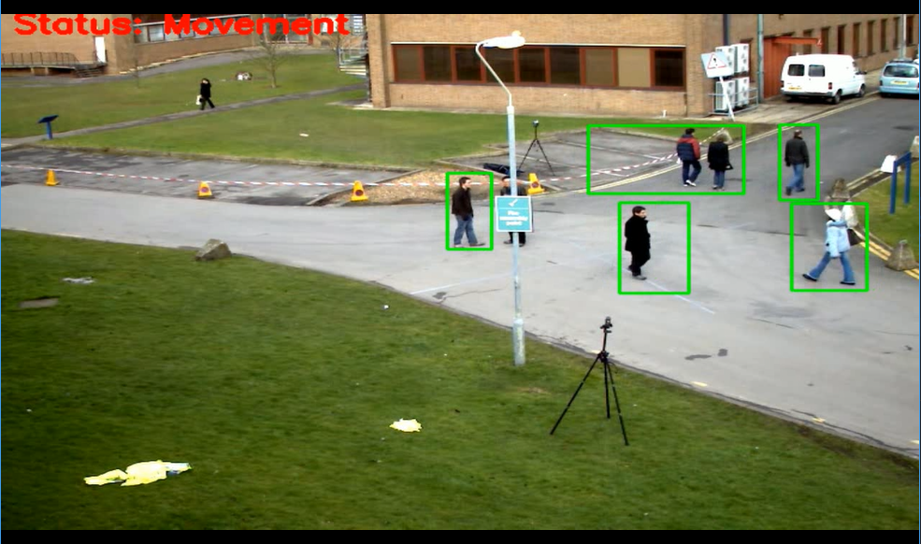
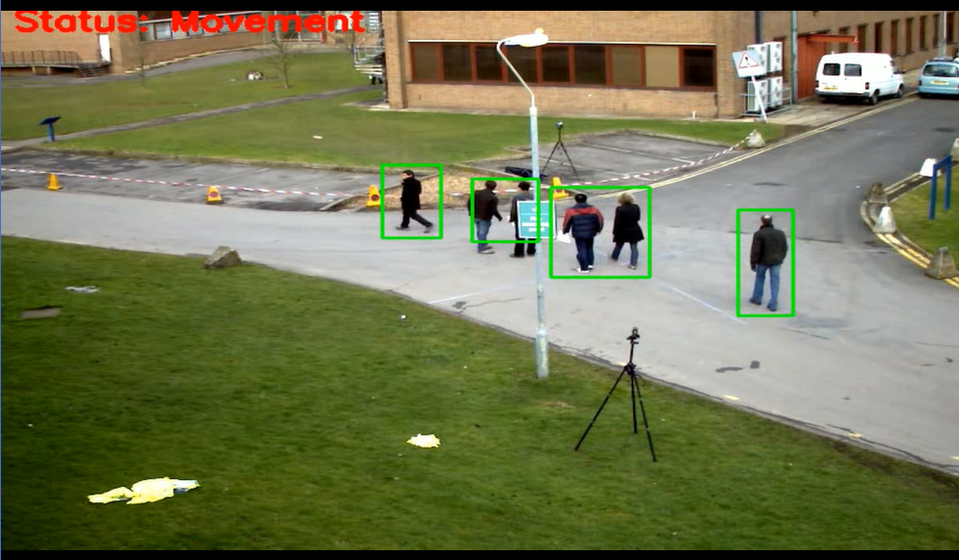
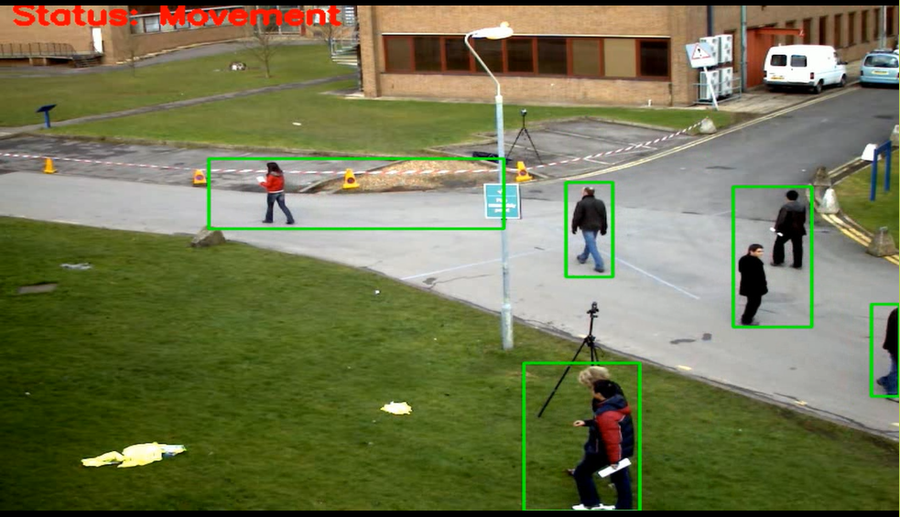
Output Screenshots
Screenshots of output

Slide 7
Acknowledgement
I would like to thank my Project guide Prof. Archana Kotangale for giving me guidance and motivation. I would also like to thank Prof. Charles Severance whose wonderful PY4E course gave me an indepth knowledge of python3 and the Coursera guided project coursework which helped me in learning the OpenCV library which is a big world in itself. Lastly but not the least, I would sincerely thank APSIT SKILLS for giving me this platform and access to wonderful courses on Coursera which have definitely helped me in this project and the skills that I have learned, I hope they keep helping me in the future !!!!

Slide 8
References
D. Lee, H. Suk, S. Park and S. Lee, "Motion Influence Map for Unusual Human Activity Detection and Localization in Crowded Scenes", IEEE Transactions on Circuits and Systems for Video Technology, vol. 25, no. 10, pp. 1612-1623, Oct. 2015.
Arun Kumar Jhapate ; Sunil Malviya ; Monika Jhapate Unusual Crowd Activity Detection using OpenCV and Motion Influence Map https://ieeexplore.ieee.org/document/9170704/
Varsha Shrirang Nanaware, Mohan Harihar Nerkar and C.M. Patil, "A Review of the Detection Methodologies of Multiple Human Tracking & Action Recognition in a Real Time Video Surveillance", IEEE International Conference on Power Control Signals and Instrumentation Engineering (ICPCSI-2017).

